Slide 1

Scio
Training

Slide 2
Agile Software Requirements
Product Backlog
User Story
Requirements Discovery
User Story Details
INVEST
Responding to Change

Slide 3
Product Backlog
High Priority
Low Priority
User Story
Detailed
Broad
User Story
User Story
Epic
Epic

Slide 4
Initial Product Backlog
INITIAL SCOPE
We want a system that solves all of our current and future problems

Slide 5
Requirements Discovery
Requirements Workshop

Slide 6
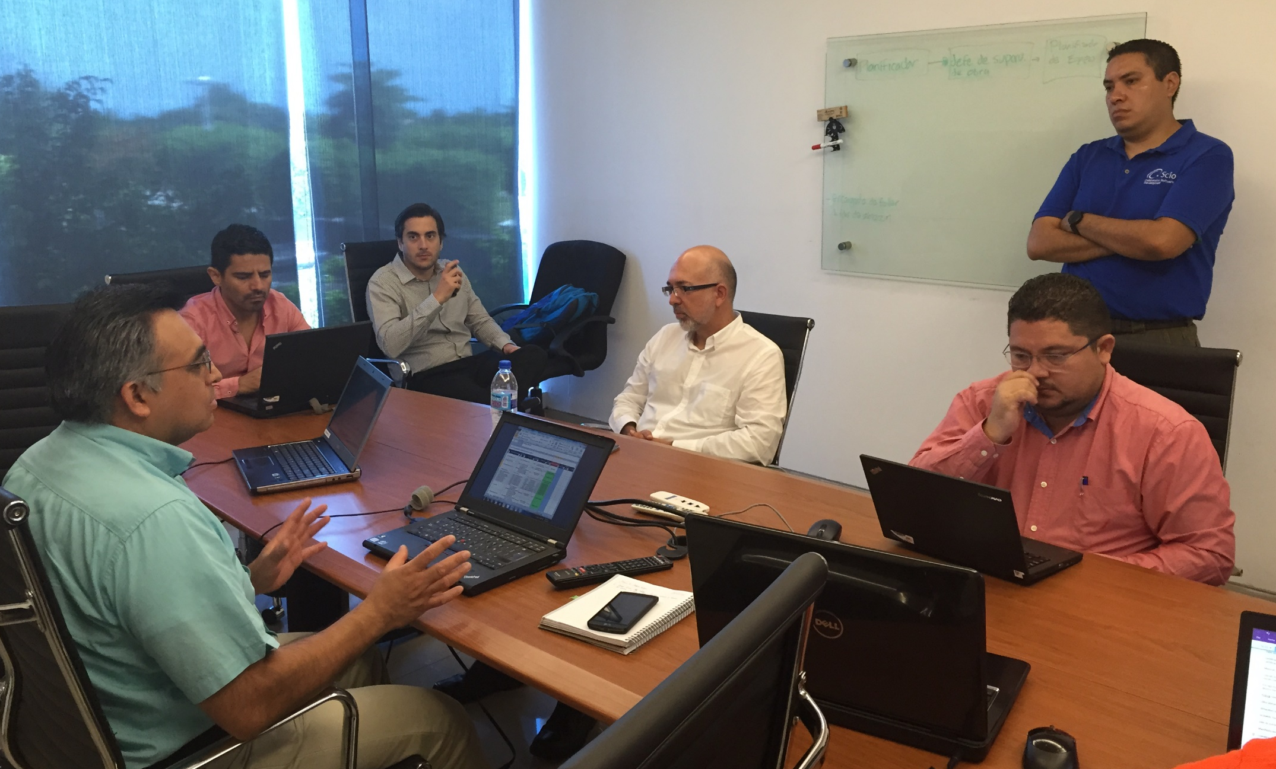
Requirements Workshop
Analyze available information
Prepare agenda
Confirm stakeholders
Run the meetings
Document discoveries

Slide 7
Requirements Workshop
Opening Questions
Describe your current process
What are the 3 most important problems you want to solve
Current situation
Constraints
Must have
Nice to have
Context

Slide 8
Initial Product Backlog
INITIAL SCOPE
We want a system that solves 3 of our current problems

Slide 9
User Story
As a [role] I can [action] so that [business value]

Slide 10

Deliver Value

Slide 11
HotelNow.com
Marketplace de habitaciones de hotel
Especializado en pequeños hoteles
Ofrece programa de lealtad
Cliente registrado
Usuario registrado que quiere ver/reservar habitaciones
Cliente anónimo
Usuario anónimo que quiere ver/reservar habitaciones
Hotelero
Gerente o persona encargada definir tarifas y disponibilidad de habitaciones

Slide 12
Conditions of Satisfaction (Acceptance Criteria)
User Story Details

Slide 13
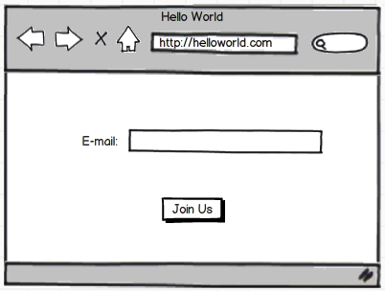
Conditions of Satisfaction (Acceptance Criteria)
User Story Details

Slide 14
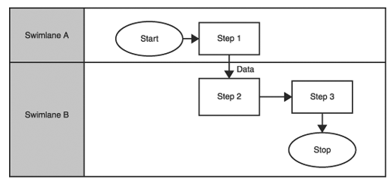
Conditions of Satisfaction (Acceptance Criteria)
User Story Details

Slide 15
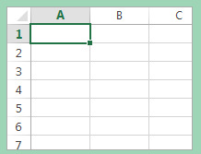



Conditions of Satisfaction (Acceptance Criteria)
User Story Details

Slide 16
an image is worth a thousand words

Slide 17
INVEST in your backlog
I
ndependent
egotiable
aluable
stimable
mall
estable
N
V
E
S
T

Slide 18
Responding to Change

Slide 19

User Story
User Story
User Story
Backlog Calamities
Epic
Epic

Slide 20
Inaccurate
User Story
User Story
User Story
Missing
Scope
creep
Epic
Epic

Slide 21

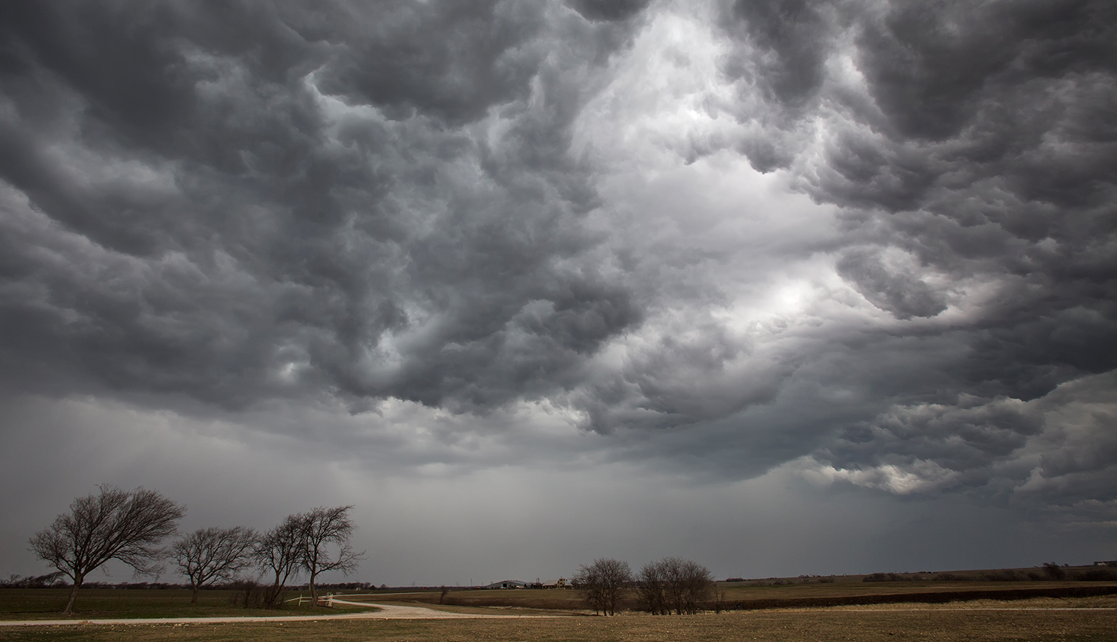
Inaccurate Requirements
Many assumptions
Gold plating
Less than needed

Slide 22
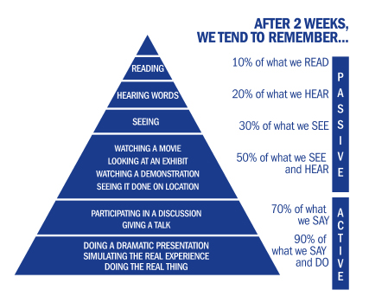

Slide 23
Missing Requirements
Agreements not documented
Deleted stories
Client forgot to mention

Slide 24
Scope Creep
Frequent new user stories
Existing stories increase in size
Saying YES to every request
Lots of rework
User stories appear from nowhere
More than one person creating stories
Saying YES to any request

